Slide 1
Water induced Restructuring of Vanadia clusters supported on a-TiO₂ (101) hydration dynamics

Slide 2
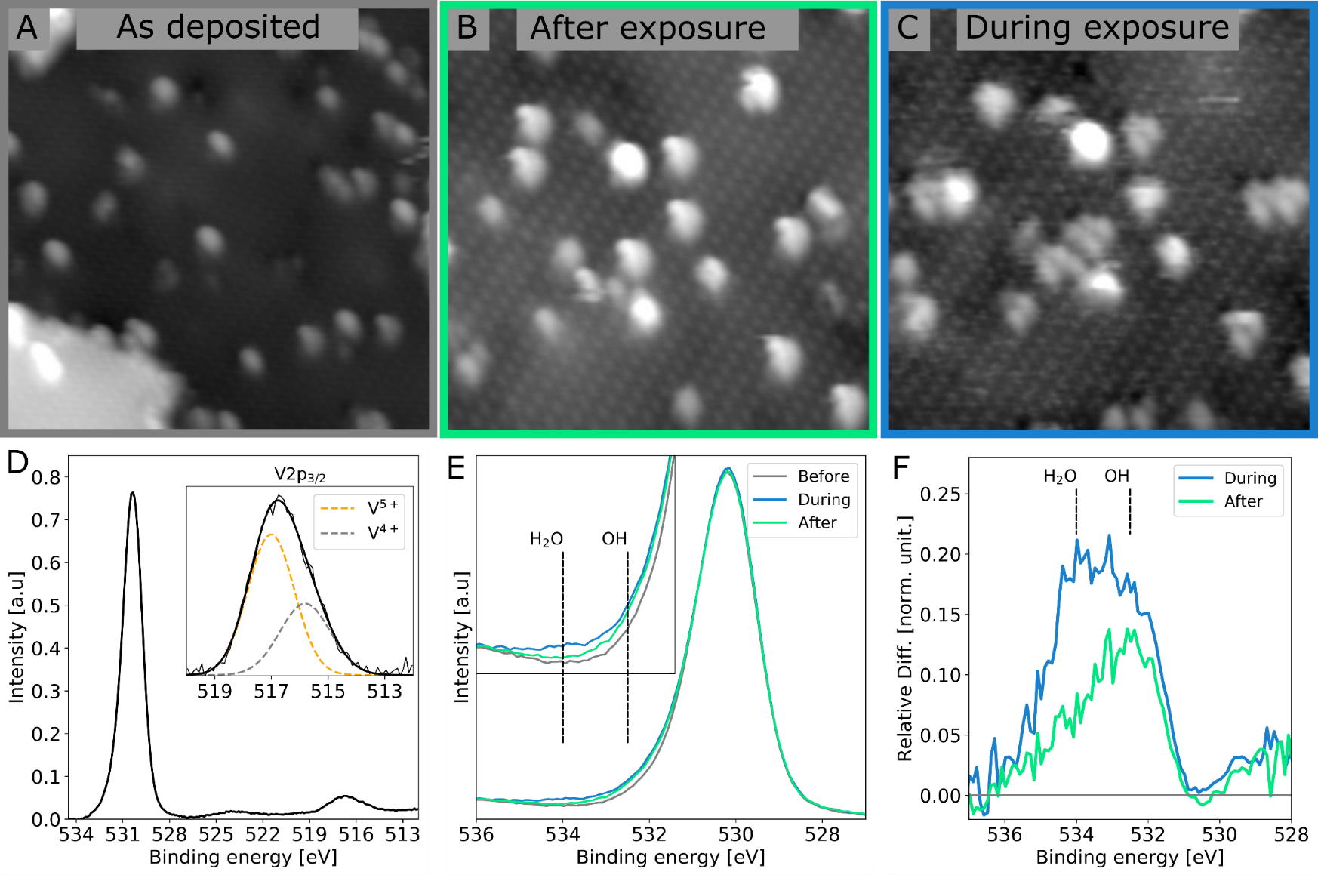
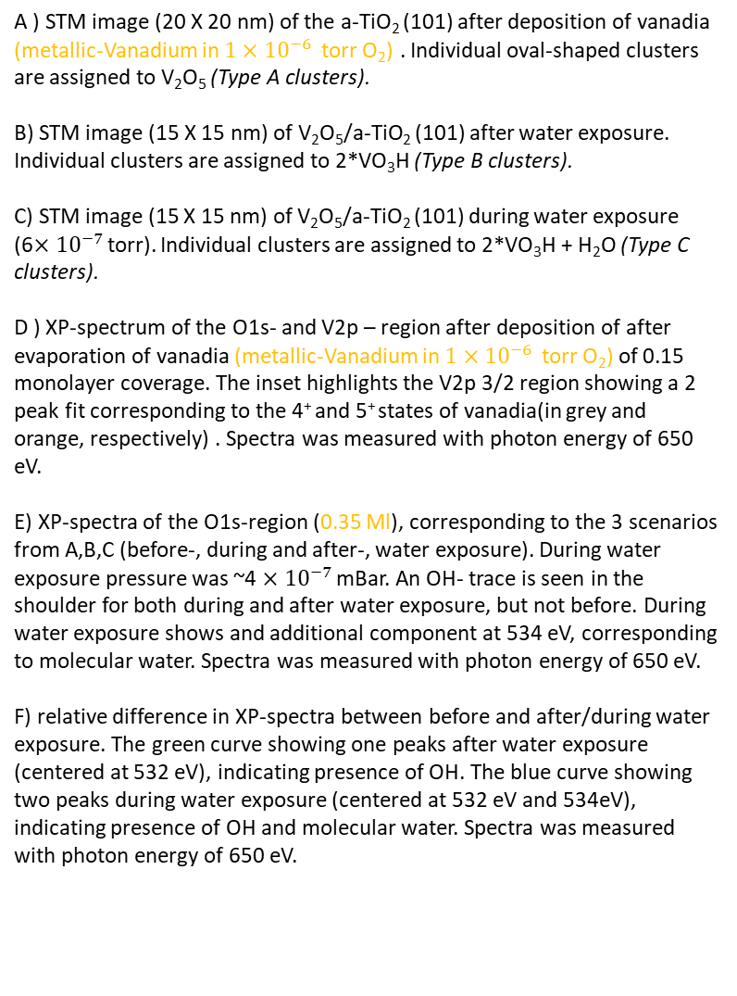
Figure 1, overview
A ) STM image (20 X 20 nm) of the a-TiO₂ (101) after deposition of vanadia (metallic-Vanadium in $1×{10}^{−6 }$ torr O₂) . Individual oval-shaped clusters are assigned to V₂O₅ (Type A clusters).
B) STM image (15 X 15 nm) of V₂O₅/a-TiO₂ (101) after water exposure. Individual clusters are assigned to 2*VO₃H (Type B clusters).
C) STM image (15 X 15 nm) of V₂O₅/a-TiO₂ (101) during water exposure (6$×{10}^{−7 }$torr). Individual clusters are assigned to 2*VO₃H + H₂O (Type C clusters).
D ) XP-spectrum of the O1s- and V2p – region after deposition of after evaporation of vanadia (metallic-Vanadium in $1×{10}^{−6 }$ torr O₂) of 0.15 monolayer coverage. The inset highlights the V2p 3/2 region showing a 2 peak fit corresponding to the 4⁺ and 5⁺ states of vanadia(in grey and orange, respectively) . Spectra was measured with photon energy of 650 eV.
E) XP-spectra of the O1s-region (0.35 Ml), corresponding to the 3 scenarios from A,B,C (before-, during and after-, water exposure). During water exposure pressure was ~4 $×{10}^{−7 }$mBar. An OH- trace is seen in the shoulder for both during and after water exposure, but not before. During water exposure shows and additional component at 534 eV, corresponding to molecular water. Spectra was measured with photon energy of 650 eV.
F) relative difference in XP-spectra between before and after/during water exposure. The green curve showing one peaks after water exposure (centered at 532 eV), indicating presence of OH. The blue curve showing two peaks during water exposure (centered at 532 eV and 534eV), indicating presence of OH and molecular water. Spectra was measured with photon energy of 650 eV.

Slide 3
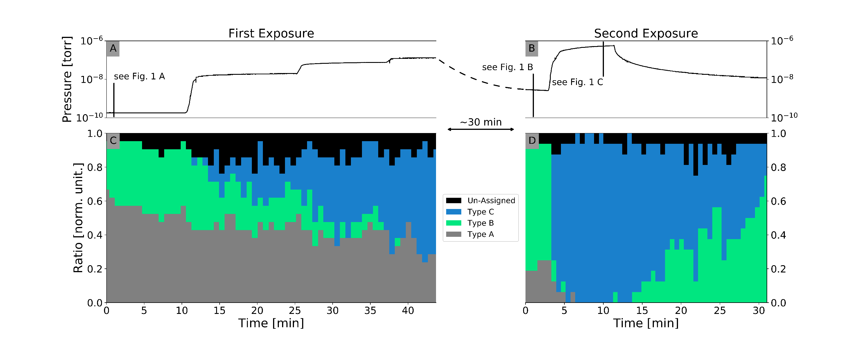
Figure 2, statistics
Figure 2:
Distributions between observed structures(type A,B and C). This figure consist of two in situ experiment in succession, where water was exposure to the vanadia covered a-TiO₂ (101) surface.(Estimated coverage ~2%)
In situ pressure measurement, measured during suppl. Movie 1.
In situ pressure measurement, measured during suppl. Movie 2.
The distribution between the three observed species during water exposure, the Type A (grey), the Type B (green) and the type C (blue) from suppl. Movie 1. the first water exposure directly after deposition. (structures are shown in figure 3)
The distribution between the three observed species during water exposure from suppl. Movie 2, the second exposure of water.
Black lines in part A and B indicate record time of figures 1A,B and C.

Slide 4
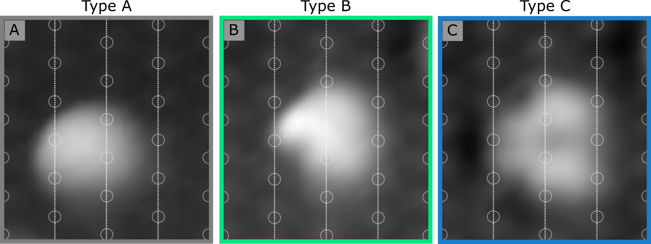
Figure 3, individual structures
Figure 3:
High resolution STM images of a vanadia features: before, after and during water exposure. A) High resolution STM image of the most common oval-shaped feature, V₂O₅ structure, found before water exposure. It extents across two Ti-5f–rows (vertical white guide-lines) and is centered between two Ti-5f – sites (grey circles)
B) High resolution STM image of the most common feature after water exposure, a 2 × VO₃H structure. It extents across two Ti-5f–rows, where the left part consists of one smaller protrusion on-top of the Ti-6f site. The right part consists of a larger protrusion also centered on top of the Ti-6f site.
C) STM image of the dehydrated structure. The right part consists of two larger protrusions centered on top of the Ti-6f site. It extents across two Ti-5f–rows. Notice the symmetry plane which lays in the horizontal plane which divides the particle in half.

Slide 5
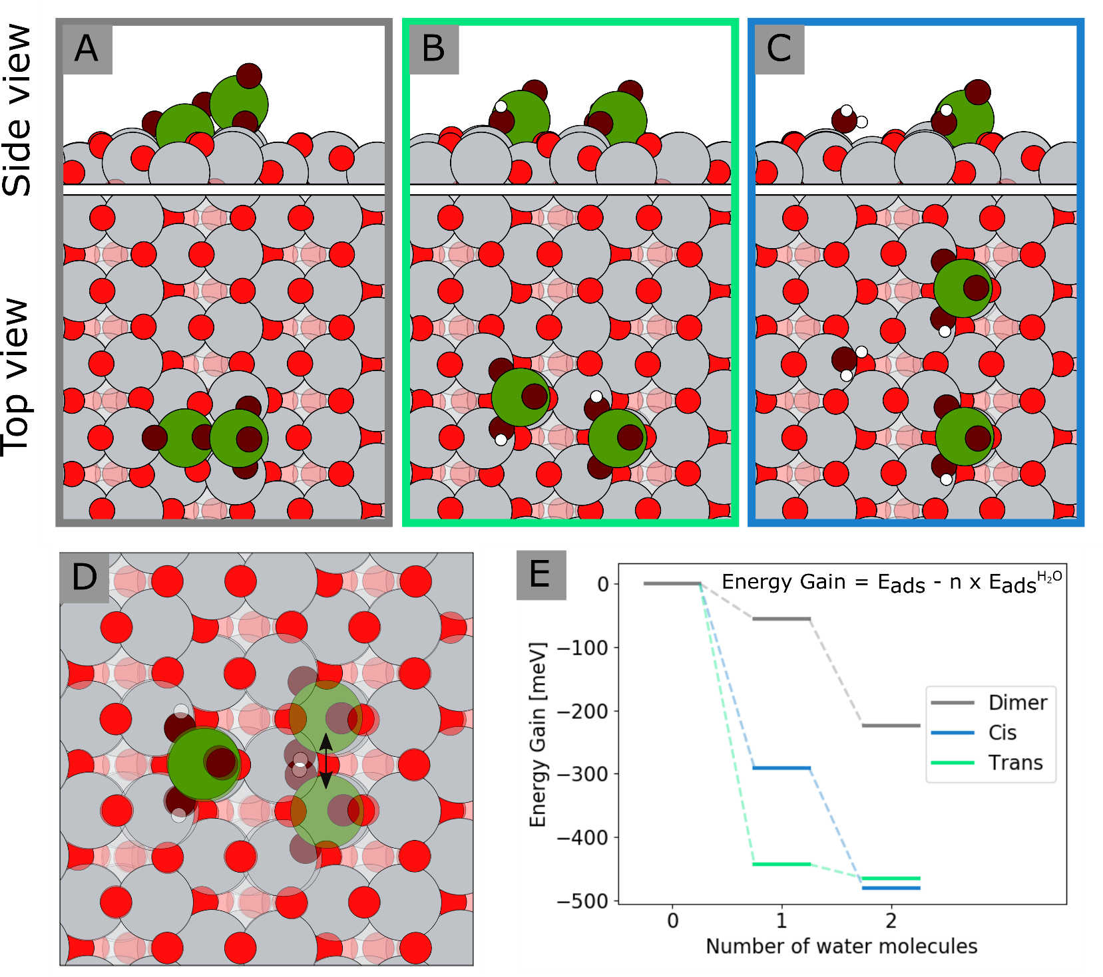
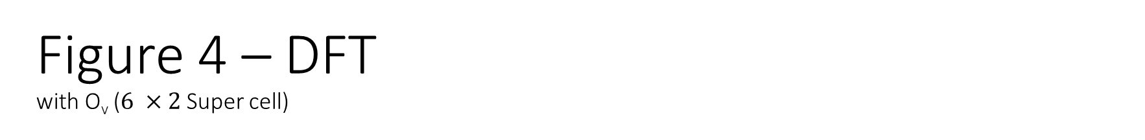
Figure 4 – DFT with O_{v} ($6 ×2$ Super cell)
Figure 4:
DFT results - A side- and top-view of :
A V₂0₅ cluster on the a-TiO₂ (101) surface. V₂0₅ takes a dimer configuration, where an oxygen is share between the two vanadium atoms. This dimers extends across the O_{br} rows. This structure reflects the symmetries found of type A from STM results. This also reflects the oxidation- and hydroxylation-state found from XPS results.
A V₂0₅ + 1 × H₂O on the a-TiO₂ (101) surface. In the addition of one water molecule the dimer configuration is no longer preferred and two VO₃H-clusters is formed. These two clusters are positioned on opposite rows (trans-configuration). The water molecule is dissociated and two hydroxyl groups are form on the two vanadia centers. Since this structure includes hydroxyls and no molecular water it corresponds to the XPS results found after water exposure(see figure 1 E and F). However the structure symmetry does not correspond to the STM Structure, a solution to this is presented in figure D.
A V₂0₅ + 2 × H₂O on the a-TiO₂ (101) surface. As for the V₂0₅ + 1 × H₂O – case this structure consists of two VO₃H-clusters. These clusters are on contrast to the previous case now positioned on the same row, leaving them more separated. The additional water molecule is adsorbed molecularly on a 5f-Ti site on the neighboring row. This structure includes both hydroxyl groups and molecular water, thus corresponding to the during water XPS- spectra. It reflects the structure found in STM result as well.
An overlap of two possible configurations of the structure presented in part B. As the Diffusion barrier for this is sufficiently low, this would be the likely representation. This structure reflects the STM structure.
Energy diagram show the energy gain; the cluster desorption energy subtracted by the adsorption energy of a non inter acting water molecule, time the number of water molecules added to the V₂0₅ – cluster. Three configurations have been considered: the dimer configuration in grey (shown in part A), the trans configuration in green ( shown in part B), the cis configuration in blue (shown in part C)

Slide 7
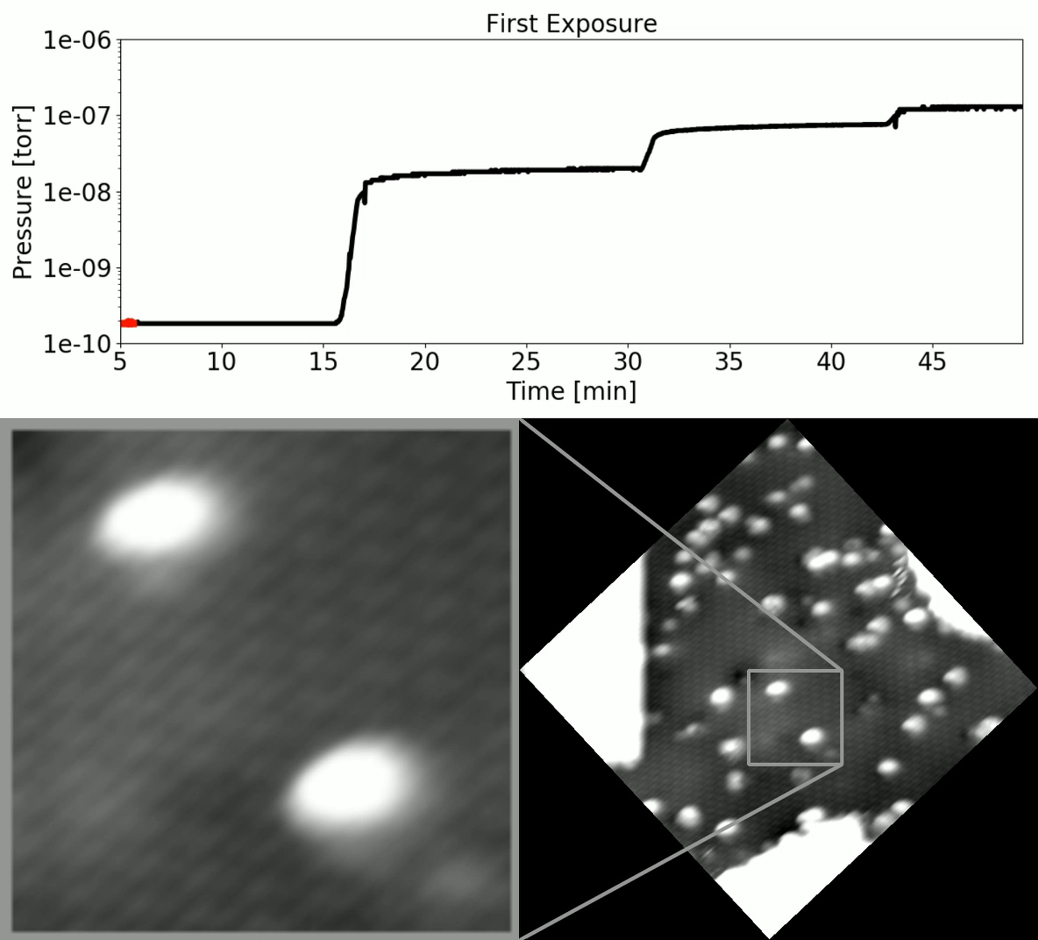
Supplementary movie 1

Slide 8
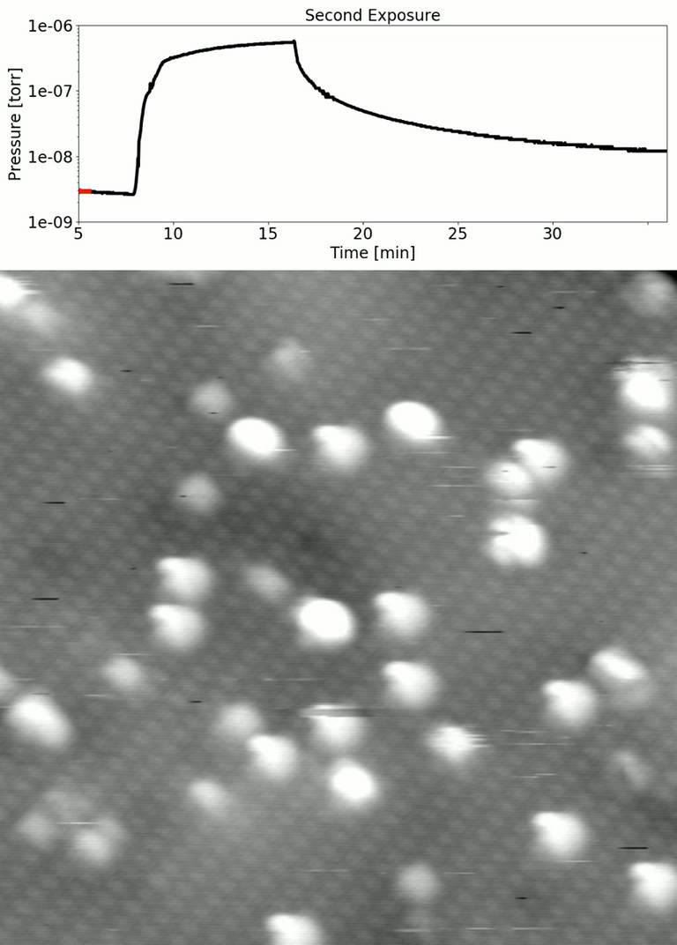
Supplementary movie 2

Slide 9
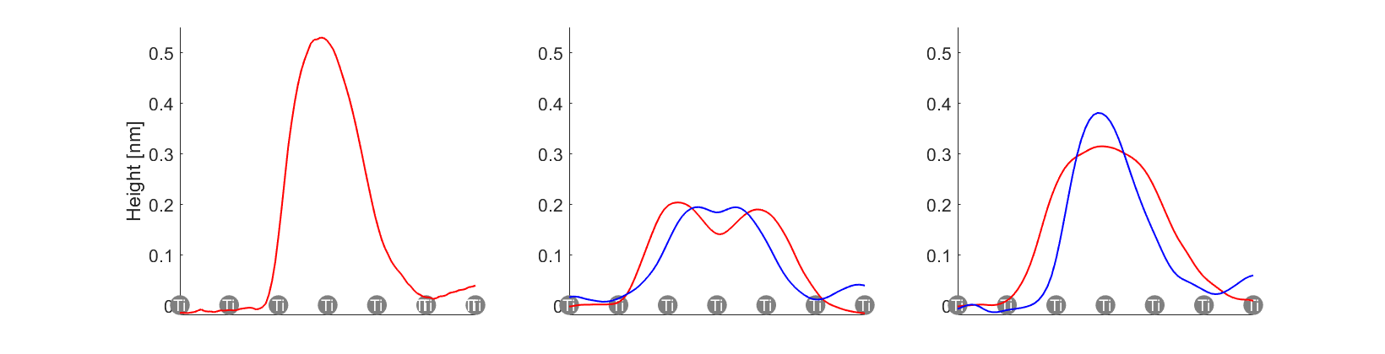
Supplementary figure 1
Type A
Type C
Type B

Slide 10
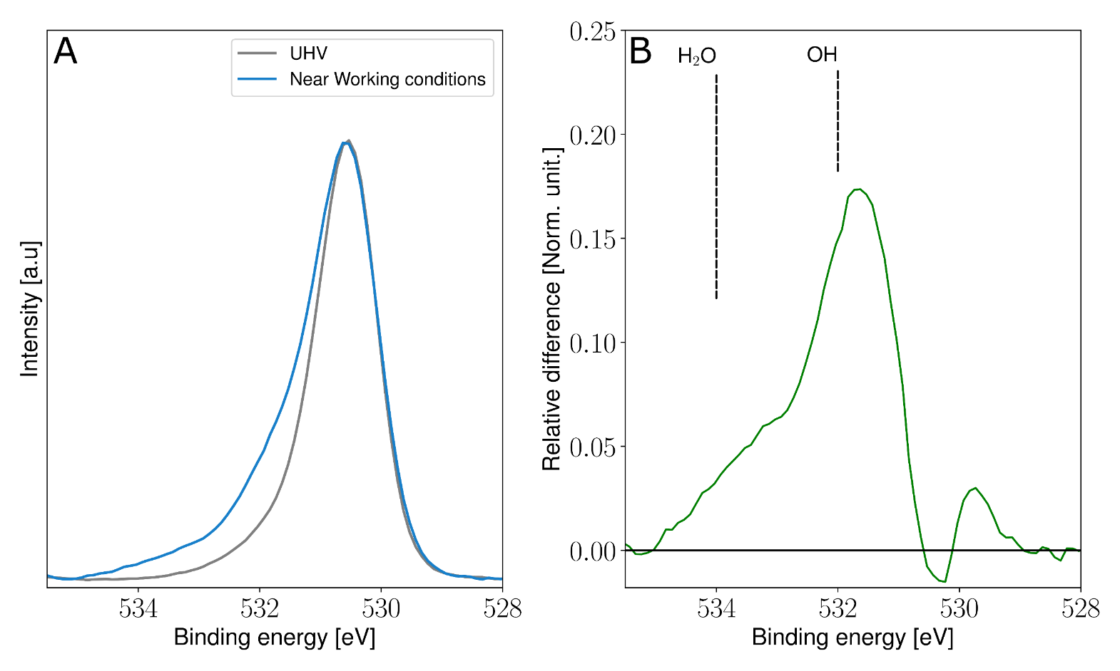
Supplementary figure 1 or figure 5
Near Ambient Pressure (NAP) – XPS measurements of the O1s- peak.
XP- spectra of the O1s-region measured after UHV preparation (grey) and during near working conditions, at 173°C and 0.6 mbar (0.5 mbar H₂0 , NH₃ 0.05 mbar, NO 0.05 mbar)
Relative difference between spectra shown in A. Two peaks are seen in this difference (centered at 532 eV and 534eV), indicating presence of OH and molecular water. Spectra was measured with photon energy of 770 eV.

